Slide 1

Diego Deep Dive

Slide 2
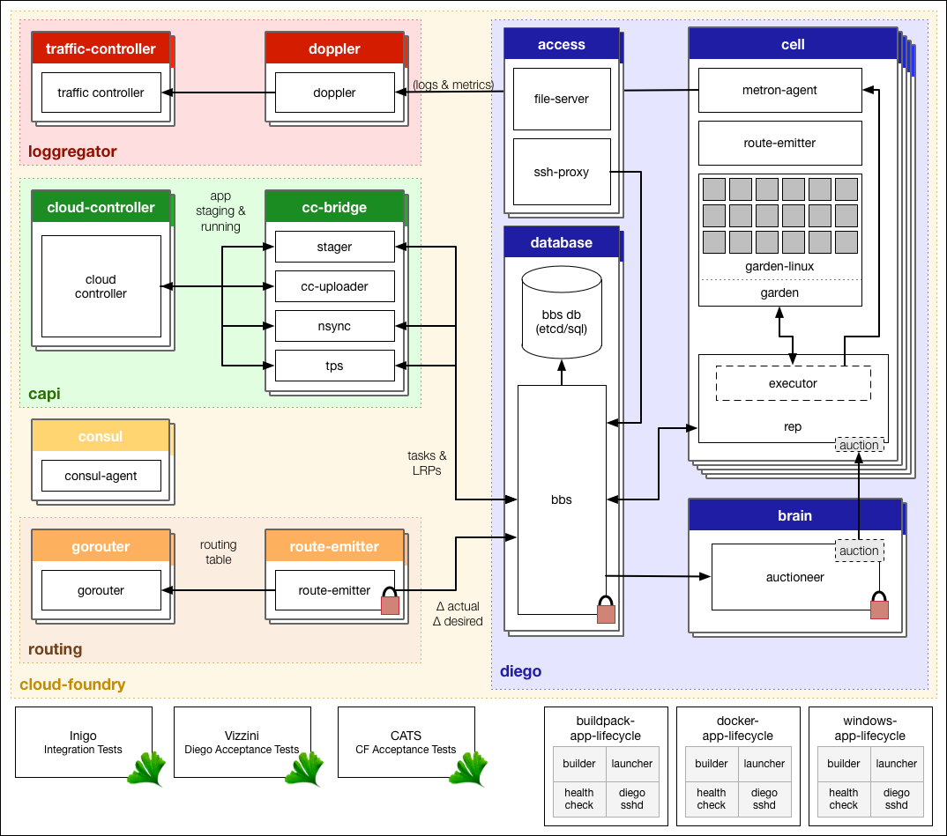
Architecture
Notes:
goal:
single platform for all devices
Increase quality and reduce the amount of stabilization
reduce planning.
PaaS is good fit for Project automatization
tests should be small.

Slide 3
Diego Components

Slide 4
Tasks and LRPs
Tasks run once, for a finite amount of time.
Examples of tasks include making a database schema change, bulk importing data to initialize a database, and setting up a connected service.
Long-Running Processes run continuously, for an indefinite amount of time.
LRPs terminate only if stopped or killed, or if they crash.
Examples include web servers, asynchronous background workers, and other applications and services that continuously accept and process input.
Notes:
goal:
single platform for all devices
Increase quality and reduce the amount of stabilization
reduce planning.
PaaS is good fit for Project automatization
tests should be small.

Slide 5
Components: Brain
Distribute Tasks and LRPs to Diego Cells
Correct discrepancies between ActualLRP and DesiredLRP
Subcomponent: Auctioneer
Auctions for Tasks and LRPs
SSL/TLS with Cell Reps
Locks in the BBS to restrict auctions to one Auctioneer at a time
Notes:
goal:
single platform for all devices
Increase quality and reduce the amount of stabilization
reduce planning.
PaaS is good fit for Project automatization
tests should be small.

Slide 6
Components: Diego Cell
Maintain tasks and LRPs
Subcomponents:
Rep
Executor
Garden
Metron Agent
Notes:
goal:
single platform for all devices
Increase quality and reduce the amount of stabilization
reduce planning.
PaaS is good fit for Project automatization
tests should be small.

Slide 7
Components: Diego Cell / Rep
Represents a Cell for Tasks and LRPs
Mediates all communication between the Cell and the BBS
Ensures synchronization and consistency with the BBS
Maintains the presence of the Cell in the BBS
Runs Tasks and LRPs
Notes:
goal:
single platform for all devices
Increase quality and reduce the amount of stabilization
reduce planning.
PaaS is good fit for Project automatization
tests should be small.

Slide 8
Components: Diego Cell / Executor
Runs as a logical process inside the Rep
Implements the generic Executor actions
Streams STDOUT and STDERR to the Metron agent running on the Cell
Notes:
goal:
single platform for all devices
Increase quality and reduce the amount of stabilization
reduce planning.
PaaS is good fit for Project automatization
tests should be small.

Slide 9
Components: Diego Cell / Garden
Provides a platform-independent server and clients to manage Garden containers
Defines the Garden-runC interface for container implementation
Notes:
goal:
single platform for all devices
Increase quality and reduce the amount of stabilization
reduce planning.
PaaS is good fit for Project automatization
tests should be small.

Slide 10
Components: Diego Cell / Metron
Forwards application logs, errors, and application and Diego metrics to the Loggregator Doppler component
Notes:
goal:
single platform for all devices
Increase quality and reduce the amount of stabilization
reduce planning.
PaaS is good fit for Project automatization
tests should be small.

Slide 11
Components: BBS (Bulletin Board System)
Maintains a real-time representation of the state of the Diego cluster
Provides an RPC-style API over HTTP
Compares the desired state vs the actual state of Tasks and LRPs
Keeps DesiredLRP count and ActualLRP count synchronized:
If the DesiredLRP count exceeds the ActualLRP count, requests a start auction from the Auctioneer
If the ActualLRP count exceeds the DesiredLRP count, sends a stop message to the Rep on the Cell hosting an instance
Monitors for potentially missed messages, resending them if necessary
Notes:
goal:
single platform for all devices
Increase quality and reduce the amount of stabilization
reduce planning.
PaaS is good fit for Project automatization
tests should be small.

Slide 12
Components: File Server
Acts as a simple “blobstore” to serves the App Life Cycle binaries:
Builder: stages a CF application. Performs static analysis on the application code and does any necessary pre-processing before the application is first run.
Launcher: runs a CF application. Executes the start command with the correct system context, including working directory and environment variables.
Healthcheck: performs a status check on running CF application from inside the container.
Notes:
goal:
single platform for all devices
Increase quality and reduce the amount of stabilization
reduce planning.
PaaS is good fit for Project automatization
tests should be small.

Slide 13
Components: SSH Server
Brokers connections between SSH clients and SSH servers running inside instance containers
Notes:
goal:
single platform for all devices
Increase quality and reduce the amount of stabilization
reduce planning.
PaaS is good fit for Project automatization
tests should be small.

Slide 14
Components: Consul
Provides:
Dynamic service registration and load balancing through DNS resolution
A key-value store for maintenance of distributed locks and component presence
Notes:
goal:
single platform for all devices
Increase quality and reduce the amount of stabilization
reduce planning.
PaaS is good fit for Project automatization
tests should be small.

Slide 15
Components: Cloud Controller Bridge
Translate app-specific requests from the Cloud Controller to the BBS
Notes:
goal:
single platform for all devices
Increase quality and reduce the amount of stabilization
reduce planning.
PaaS is good fit for Project automatization
tests should be small.

Slide 16
Components: CC-Bridge / Stager
Translates staging requests from the Cloud Controller into generic Tasks and LRPs
Sends a response to the Cloud Controller when a Task completes
Notes:
goal:
single platform for all devices
Increase quality and reduce the amount of stabilization
reduce planning.
PaaS is good fit for Project automatization
tests should be small.

Slide 17
Components: CC-Bridge / CC-Uploader
Mediates uploads from the Executor to the Cloud Controller
Translates simple HTTP POST requests from the Executor into complex multipart-form uploads for the Cloud Controller
Notes:
goal:
single platform for all devices
Increase quality and reduce the amount of stabilization
reduce planning.
PaaS is good fit for Project automatization
tests should be small.

Slide 18
Components: CC-Bridge / NSync
Listens for app requests to update the DesiredLRPs count and updates DesiredLRPs through the BBS
Periodically polls the Cloud Controller for each app to ensure that Diego maintains accurate DesiredLRPs counts
Notes:
goal:
single platform for all devices
Increase quality and reduce the amount of stabilization
reduce planning.
PaaS is good fit for Project automatization
tests should be small.

Slide 19
Components: CC-Bridge / TPS
Provides the Cloud Controller with information about currently running LRPs to respond to cf apps and cf app APP_NAME requests
Monitors ActualLRP activity for crashes and reports them the Cloud Controller
Notes:
goal:
single platform for all devices
Increase quality and reduce the amount of stabilization
reduce planning.
PaaS is good fit for Project automatization
tests should be small.

Slide 20
Components: Route Emmiter
Acts as either one global route-emitter or local route-emitters on each Diego cell
Monitors DesiredLRP and ActualLRP states, emitting route registration and unregistration messages to the Cloud Foundry router when it detects changes
Periodically emits the entire routing table to the Cloud Foundry router
Notes:
goal:
single platform for all devices
Increase quality and reduce the amount of stabilization
reduce planning.
PaaS is good fit for Project automatization
tests should be small.

Slide 21
Garden backends
Create and delete containers
Apply resource limits to containers
Open and attach network ports to containers
Copy files into and out of containers
Run processes within containers
Stream STDOUT and STDERR data out of containers
Annotate containers with arbitrary metadata
Snapshot containers for redeploys without downtime
Notes:
goal:
single platform for all devices
Increase quality and reduce the amount of stabilization
reduce planning.
PaaS is good fit for Project automatization
tests should be small.

Slide 22
Garden-runC
Linux-specific implementation of the Garden interface using the Open Container Interface (OCI) standard.
Uses the same OCI low-level container execution code as Docker and Kubernetes
AppArmor is configured and enforced by default for all unprivileged containers
Seccomp whitelisting restricts the set of system calls a container can access, reducing the risk of container breakout
Allows pluggable networking and rootfs management
Notes:
goal:
single platform for all devices
Increase quality and reduce the amount of stabilization
reduce planning.
PaaS is good fit for Project automatization
tests should be small.

Slide 23
Container Mechanics
Namespacing of Kernel resources
Every container includes:
a private root filesystem, which includes:
a Process ID (PID)
a namespace
a network namespace
amount namespace.
Read-filesystem is shared
Read-write filesystem is unique to each container
Resource control is managed by cgroups
Notes:
goal:
single platform for all devices
Increase quality and reduce the amount of stabilization
reduce planning.
PaaS is good fit for Project automatization
tests should be small.

Slide 24
Diego’s Auctioneer System

Slide 25
Auctioneer basics
Balances application processes (a.k.a. jobs) in Cells.
Determines which new processes should run on which Cells.
Balances the load on Cells
Optimizes application availability and resilience
Jobs are auctioned in batches
Only one action can happen at the same time
Notes:
goal:
single platform for all devices
Increase quality and reduce the amount of stabilization
reduce planning.
PaaS is good fit for Project automatization
tests should be small.

Slide 26
The Auction Batch
Auctioneer allocates jobs to Cells to fulfill the following conditions:
Keep at least one instance of each LRP running
Run all of the Tasks in the current batch
Distribute as much of the total desired LRP load as possible over the remaining available Cells, by spreading multiple LRP instances broadly across Cells and their Availability Zones
Notes:
goal:
single platform for all devices
Increase quality and reduce the amount of stabilization
reduce planning.
PaaS is good fit for Project automatization
tests should be small.

Slide 27
The Auction Batch Target
Auctioneer allocates jobs to Cells to fulfill the following conditions:
Keep at least one instance of each LRP running
Run all of the Tasks in the current batch
Distribute as much of the total desired LRP load as possible over the remaining available Cells, by spreading multiple LRP instances broadly across Cells and their Availability Zones
Notes:
goal:
single platform for all devices
Increase quality and reduce the amount of stabilization
reduce planning.
PaaS is good fit for Project automatization
tests should be small.

Slide 28
The Auction Process
Auctioneer arranges the jobs by priority order
First instances come first
Tasks are next
Duplicated instances are last
For every job, VMs “bid” on their capacity to receive the job
The “Cell” included in the VM acts on behalf of the VM itself.
The auctioneer polls the VMs on their fitness to run the job
When the list of jobs is over, tje Auctioneer submit requests to the Cells to execute the allocated job.
If the Cell runs out of resources to run the allocated job, the job is merged into the next batch to be relocated
Notes:
goal:
single platform for all devices
Increase quality and reduce the amount of stabilization
reduce planning.
PaaS is good fit for Project automatization
tests should be small.

Slide 29
The Auction Process / VM bid priorities
Allocate all jobs only to Cells that have:
the correct software stack to host them
sufficient resources given their allocation so far during this auction.
Allocate LRP instances into Availability Zones that are not already hosting other instances of the same LRP.
Within each Availability Zone, allocate LRP instances to run on Cells that are not already hosting other instances of the same LRP.
Allocate any job to the Cell that has lightest load, from both the current auction and jobs it has been running already.
Notes:
goal:
single platform for all devices
Increase quality and reduce the amount of stabilization
reduce planning.
PaaS is good fit for Project automatization
tests should be small.

